Slide 1
Deep Learning over Knowledge Graphs
Doug Sherman, Cesar Bortolo, Kevin Jesse, Nicholas Joodi

Slide 2
Knowledge Graph Completion
Knowledge base composed of concepts and relations
Problem: Missing relations between these concepts → incomplete knowledge base
Representation:
Concepts = nodes
Relations = edges
→ Knowledge graph
Solution: knowledge Graph Completion

Slide 3
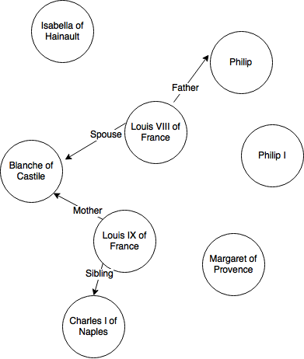
Knowledge Graph Completion

Slide 4
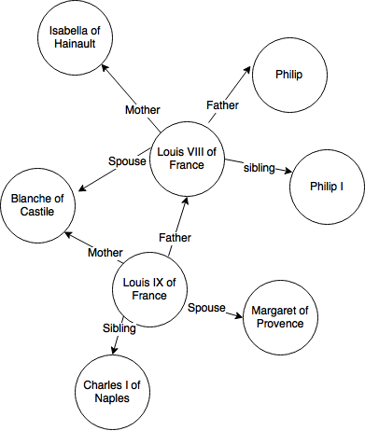
Knowledge Graph Completion

Slide 5

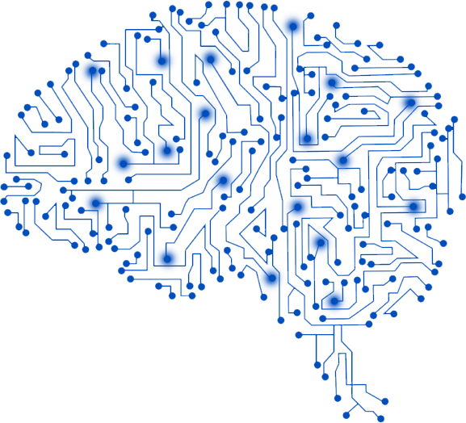
Approach
2. Numerical representation
4. Predictions
Embeddings
Facts
1. Extract subset of Wikidata
3. Neural Tensor Network /
Multilayered Perceptron

Slide 6
Data Collection & Curating
Demonstration using Wikidata service
Extract subset of WikiData
Create entity embeddings
Construct training and test data sets
SELECT ?human ?humanLabel ?spouse ?spouseLabel WHERE {
?human wdt:P31 wd:Q5.
?human wdt:P26 ?spouse.
SERVICE wikibase:label { bd:serviceParam wikibase:language "en". }
?human wdt:P40 wd:Q15070044.
}
LIMIT 1

Slide 7
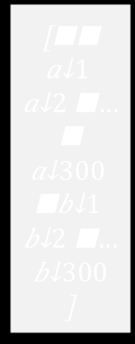
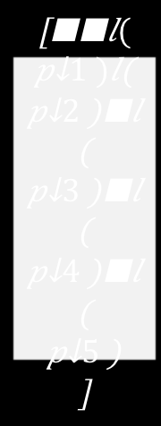
Multilayered Perceptron Architecture
Learning Function
Input
Hidden
Layer 1
Hidden
Layer k
Output
$$\left[\begin{matrix}\begin{aligned}a_{1} \\ a_{2} \\ \begin{aligned}… \\ \begin{aligned}a_{300} \\ \begin{aligned}b_{1} \\ b_{2} \\ \begin{aligned}… \\ b_{300}\end{aligned}\end{aligned}\end{aligned}\end{aligned}\end{aligned}\end{matrix}\right]$$
a_{h}(z)
$$\left[\begin{matrix}\begin{aligned}l(p_{1}) \\ l\left(p_{2}\right) \\ \begin{aligned}l\left(p_{3}\right) \\ \begin{aligned}l\left(p_{4}\right) \\ \begin{aligned}l\left(p_{5}\right)\end{aligned}\end{aligned}\end{aligned}\end{aligned}\end{matrix}\right]$$
…
a_{h}(z)
a_{out}(z)
a_{h}(z)
300 x 1
N_{L1} nodes
N_{Lk} nodes
5 x 1
Update Function

Slide 8
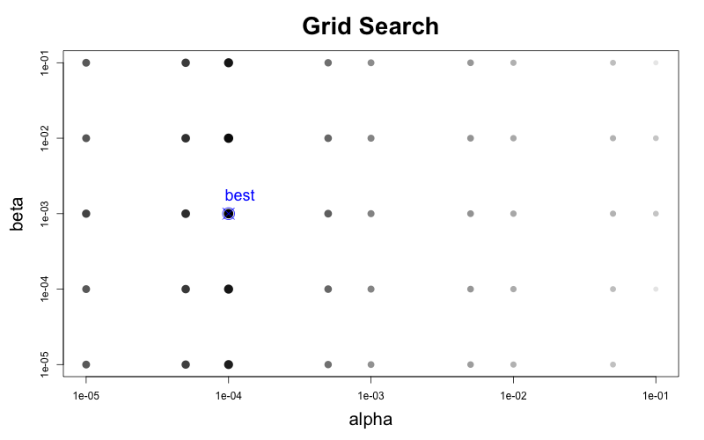
MLP Hyper Parameter Optimization

Slide 9
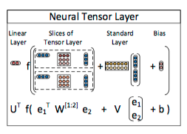
Neural Tensor Network Architecture
U, W, V, and b are the parameters in the scoring function
f is the tanh activation function
e₁ and e₂ are the entity embeddings passed as inputs

Slide 10
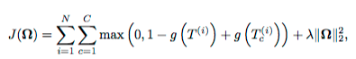
Neural Tensor Training
Contrastive max margin loss:
For every positive triplet in the training set, corrupt it, and it should receive a higher score than the corrupted triplet
Ω is the network parameters, N is the number of samples. C is the corruption size, λ is the regularization term, g is the scoring function
Essentially train the model to increase the margin between the scores for a correct triplet with respect to a corrupted triplet

Slide 12
Test set construction
Problem: Significantly more negative samples than there are false
Example: 5 types of relations, 2000 entities = roughly 20000000 variations
A classifier that simply returns negative could perform very well
Solution: Create a more realistic, harder test criteria
For every positive triplet, create a negative triplet by replacing the tail entity
Example:
Positive Triplet: {Barack Obama, father, Maliah Obama}
False Triplet creation: {Barack Obama, father, Chelsea Clinton}
Will not create: {Maliah Obama, father, Chelsea Clinton}
since Maliah Obama never showed up as the head entity for that relation
50% positive test cases and 50% negative test cases

Slide 13
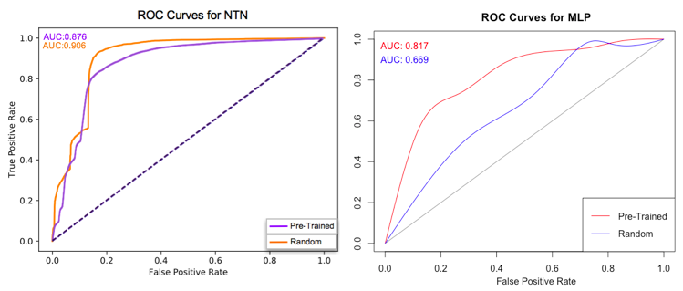
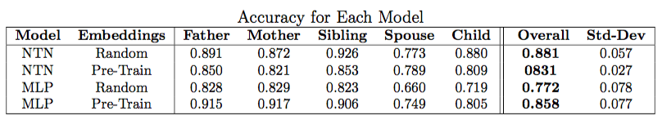

Slide 14
End notes
MLP
Benefits
Faster training time
Performed well over relatively sparse pretrained word embeddings
Disadvantage
Did not perform as well overall
NTN
Benefits
Overall, outperformed MLP
Learns semantic representation of entity embeddings
Disadvantage
Very long training time
Future work
Execute the models over pretrained embeddings that represent all words in the knowledge graph

